Slide 1

Welcome to the
NRCS Fees and Levy Tariffs Consultation Sessions for 2018/2019
Date: 22 March 2018

Slide 2

Presentation Outline
Overview of the NRCS
Background to the organisation
Legislative mandate
Mission and Vision
NRCS Value Chain
Regulated Industries
NRCS performance
Challenges
Strategies
Financial Information
Financial Status: Income Statement
Financial Status: Revenue
Completeness of Levies
Annual Levy Declaration: Deadlines
Other Financial Matters
Proposal increases for the 2018-2019 Financial Year
Business Units Scope, Approach, Rationale and Levy Increase Proposals

Slide 3
Background to the Organisation
The National Regulator for Compulsory Specifications (NRCS) was established on 1 September 2008 as an agency of the dti. Its broad mandate is to promote public health and safety, environmental protection and fair trade through the administration, maintenance and enforcement of Technical Regulations (TRs) and Compulsory Specifications (VCs).

Slide 4

Legislative Mandate
Mandate of the NRCS is derived from the following Acts.
National Regulator for Compulsory Specifications Act
(Act No. 5 of 2008)
Legal Metrology Act
(Act No. 9 of 2014)
National Building Regulations and Building Standards Act
(Act No. 103 of 1977)
The Foodstuffs, Cosmetics and Disinfectants Act
(Act 54 of 1972)

Slide 5
NRCS Strategic goals, Mission and Vision
NRCS Strategic Goals
Mission & Vision
To ensure an optimally capacitated institution
To develop, maintain and administer compulsory specifications and technical regulations
To maximise compliance with all specifications and technical regulations
To inform and educate our stakeholders about the NRCS
Mission
Vision
A credible and respected regulator for the protection of the public, the economy and the environment
To develop compulsory specifications and technical regulations, and maximise compliance of regulated products and services

Slide 6
NRCS Value chain
Request for regulation
Enforcement of Regulations
Development of TR
Pre- market approval
Inspection
Sampling
Testing
Sanction
In-house Technical Specialist
Industry Participation
Use of SANS if available
Admin Process
LOA & Sales Permit
Proof of Compliance
In-house Inspectors
Automotive
Chemicals & Materials
Electro-technical
Food
Random
On request
Accredited testing facilities
Accounting Authority

Slide 7
Regulated Industries
Industry Sector | Product regulated / Service rendered
Automotive | Vehicles, Replacements Components, Manufactures Importers and Builders
Chemicals, Materials and Mechanicals | Building Materials (cement, treated timber, safety glass & glazing material), Chemicals (disinfectants & detergent-disinfectants), Micro-biological safety cabinets, Personal Protective equipment (swimming aids, personal flotation devices, respirators & safety footwear), Firearms & Shooting Ranges, plastic carrier bags, cigarette lighters, non-pressure paraffin stoves & heaters, pressurized paraffin appliances
Electro-technical | Electrical Appliances and Products, Electronic appliances and products
Food and Associated Industries | Fishery products and canned meat
Legal Metrology | Measurable Products and Services, measurements in trade, health, safety and the environment, any measuring instrument used for a prescribed purpose and gaming equipment
Building Regulations | Ensure uniform interpretation of National Building Regulations and Standards Act, administer review Board

Slide 8
Organisational Performance
Performance highlights
Non-compliant products to the value of R239 million were removed from the market.
The NRCS conducted 48 634 inspections
The NRCS issued 17 484 approval certificates for Electro-technical (69%), Automotive (21,6%) and Chemicals, Materials and Mechanicals (7,6%) products
Issued 9 522 health guarantees which ensured that all exported fishery and associated products were accepted in foreign markets.
Corporate social investment (Safe paraffin stove campaign was implemented)
Levy Audit successes (R9.5m in Q2 of 2017)

Slide 9
Challenges
Challenges
Inadequate testing facilities in South Africa for some regulated products e.g. Motor cycle helmets
Capacity constraints, given resources available
Escalating cost of regulation
Importation of products without NRCS approval
Generation of revenue reliant on trends and markets
Non-compliant levy payers
Internal control weaknesses – ICT system

Slide 10
Strategies
Strategies and plans
Collaboration with key stakeholders – SARS, SAPS, NCC and other government departments & entities
System modernisation
Border enforcement
Risk-based approach
Ensure compliance of levy declarations as per Act and Regulations
Improve Levy collections
Improve LOA turnaround times

Slide 11
Financial information
Financial information of the organisation

Slide 12
Financial Status: Income Statement

Slide 13
Financial Status: Revenue

Slide 14
Financial Status: Revenue

Slide 15
Completeness of Levies
The following factors have contributed to the incompleteness of levies:
Bona fide error
If a levy payer has incorrectly classified the levy commodity which they manufacture, import or build this results in a bona fide error. Lists of regulated products are available on the NRCS website www.nrcs.org.za and technical specialists are available to advise / guide.
Under-Declaration
The NRCS has the right to request any information it deems necessary for a period of five years.
If under-declaration is suspected please notify a Levy Officer. A Levy Auditor will be appointed to investigate.
Non-Submission of Returns
As at March 2018, 59% of the levy returns due to the NRCS had not been submitted yet
As per the NRCS Act of 2008, the NRCS can estimate levies payable and invoice the client
A levy is the equivalent of a tax
If the NRCS does not recognise all levies due to it, its revenue is incomplete
Plans such as levy audits and reminders are under way to address / return to compliance

Slide 16
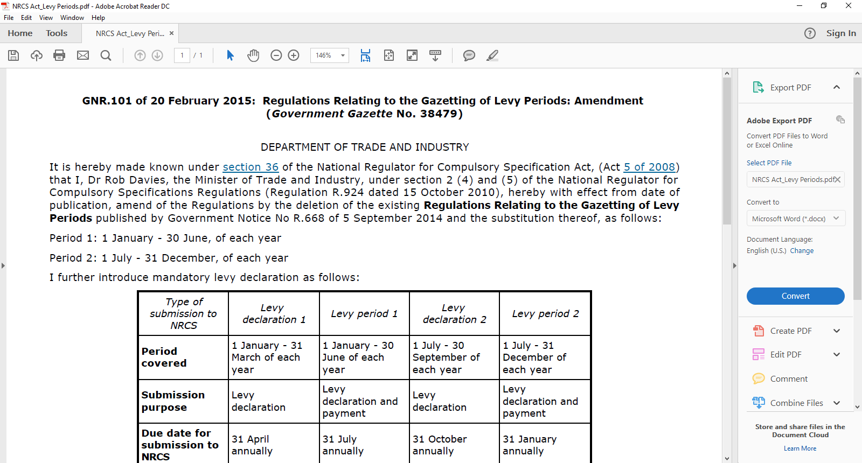
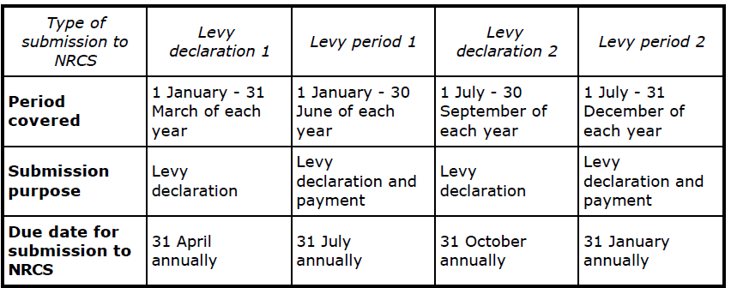
Annual Levy Declaration: Deadlines

Slide 17
Other Matters
Successes
Strengthened Levy Audit functions
Compliance check on applications (Levy, Debtors, Fees)
Challenges
Some clients in the industry are none compliant (levy declarations, payment)
Some clients do not declare their levy commodities in full
Some of clients do not submit their quarterly declarations
In most cases clients will make a payment without submitting a completed levy declaration
Some clients will declare Nil Returns every year even after an LOA has been issued
Adverse economic conditions
Declining government funding
Key Strategies to address the Challenges
Automation of the NRCS levy declaration function
Levy audit focus on non-compliance (under-declaration, incorrect declaration, non-declaration)
Ensure clients submit returns accurately and timeously as per the NRCS Regulations
By the end of March 2018, in case of non-compliant clients, the NRCS will estimate levies payable and issue an invoice by using prior year declarations

Slide 18
Levy Increase Proposals for the 2018-2019 Financial Year
Overall proposal
NRCS will maintain a fixed increase of an average of 6% - as per the previous year 2017-2018
Stats SA has released a report in January 2018 indicating the average annual consumer price inflation of 5.3% in 2017
The average annual Consumer Price Inflation remained at a 3% to 6% target band for 2017
This is a 1.1 percentage points lower than the corresponding average of 6.4% in 2016
Levy tariffs
Foods and Associated Industries (FAI)
Tariffs will vary for various categories of products

Slide 19
Business Units Scope, Approaches and Rationale
Divisional Scope, Approach, Rationale and Levy Increase Proposals

Slide 20
Automotive Business Unit
Scope of work
  Self-propelled motor vehicles (cars, bakkies, busses, trucks, motorcycles, three wheeled vehicles)
  Trailers (caravans, light and heavy trailers, interlinks, tipper and tank trailers
  Replacement components (Lights, safety glass, brake pads, brake shoes, elastomeric cups and seals, hydraulic brake and clutch fluid)
  Agricultural tractors
  Motorcycle safety helmets
  Child restraints for use in motor vehicles
  Pneumatic tyres for passenger, commercial motor vehicles and trailers
  Ball type couplings and towing brackets for towing caravans and light trailers
    National Road Traffic Act & Regulations
    Inspectorate of Manufacturers, Importers & Builders of motor vehicles

Slide 21
Automotive: Activities
Inspectorate: manufacturers, importers & builders of motor vehicles
Premarket approval
Market surveillance
Port of entry inspections
Stakeholder engagements with industry
Regulatory matters
Investigation of complaints and concerns of suspected non-compliant products
Sanctions of non-compliant products
International liaison on vehicle regulations harmonization

Slide 22
Automotive: Rationale for Levy Increase Proposals 2019
Rationale
High costs associated with destruction of non-compliant products identified in the market.
Reduced economic activities resulting in reduced volume of levy payable product.
Increase in scope of technical regulations as a result of proposed amendments of some compulsory specifications

Slide 23
Automotive Levy Increase Proposals 2019
l

Slide 24
CMM
Scope of Work
  Personal protective equipment
  Firearms & associated commodities
  Flame-producing devices
  Health related products
  Construction materials

Slide 25
CMM: Rationale for Levy Increases 2019
  Rationale
  To effectively regulate industries
  To improve coverage
  To acquire resources such as human capital and to cover destruction, storage and transportation costs
  To process applications for approval of various commodities
  To cover legal costs

Slide 26
CMM: Levy Increase Proposals 2019

Slide 27
Electro-technical Scope
  Cord sets and cord extension sets
  Earth leakage protection units
  Circuit breakers
  Manually operated switches for fixed installations
  Flexible cords for appliances
  Plugs, socket-outlets and socket outlet adaptors
    Safety of appliance couplers
    Tubular fluorescent lamps
    Incandescent lamps
    Manually operated switches for appliances
    Electrical and electronics apparatus
    Household Appliances and Similar apparatus
    Audio Visual Equipment and Apparatus
    Portable Electrical Power tools
  National Gambling Act (Act 7 of 2004)

Slide 28
Electro-technical: Rationale for Levy Increase Proposals 2019
Economic and Social conditions resulting to high demand of cheaper goods: South Africa is experiencing a flooding of non-complying (unsafe and harmful to human consumption) consumer goods
Reduced product life-cycles: products become absolute while LOA is still valid
Increase in scope of technical regulations: 6 additional trainee inspectors appointed to assist with the ever increasing workload
Unavailability and fewer test laboratories: High testing cost in SA and some tests done abroad due to unavailability of laboratories in SA
Exchange rate factors further increase costs

Slide 29
Electro-tech Levy Increase Propsoals 2019

Slide 30
FAI
Scope of Work
  Frozen Fish, Frozen Marine Molluscs and Frozen products
  Canned: Fish, Marine Molluscs and Crustaceans
  Frozen Rock Lobster Products Derived therefrom
  Frozen Shrimps (Prawns), Langoustines and Crabs
  Smoked Snoek
  Live Aquaculture Abalone
  The Manufacture, Production, Processing and Treatment of
  Canned Products
Foodstuff’s Cosmetics and Disinfectants Act, Act 54 of 1972
  Inspectorate of various food types and Manufacturers

Slide 31
FAI: Rationale
Rationale for FAI proposed increases
Fee disparity between low volume and high volume producers
SMME’s disadvantaged financially
Intra-Industry cross subsidisation
To provide a more equitable basis for pricing between high volume producers/ importers and low volume producers/ importers
FAI Unit not fully funded – Loss of R 9 million as at 31 March 2017
Levy increase alternatives
Levy scale review
Single scale for levies

Slide 32
FAI Levy Increase Proposals 2019

Slide 33
Legal Metrology - Scope
  The Business Unit administers the Legal Metrology Act (Act 9 of 2014)
  Contributing to the orderly conduct of commerce
  The protection of all participants through ensuring equity and correctness of measurements
  The promotion of consumer and international confidence in trade measurements, in all trade and legal dealings where measuring instruments are used as a basis for the transaction

Slide 34
Legal Metrology: Rationale
Rationale
Legal Metrology is funded by government grant, which is being reducing
Legal Metrology will commence with the registration of manufacturers, importers and persons who offer for sale any prescribed measuring instruments, product or service.(Legal metrology Act 2014 (Act 9 of 2014) Section 11 when Regulations are promulgated
Approach
These fees are applicable to the following:
  verification
  type approval services
  calibration of masspieces, balances and volume measure
  verification Officers examinations and practical evaluations
  certificate of authority to verify
  application for letter of compliance and update of letter of compliance (LOC) – fees must be prepaid and non-refundable

Slide 35
Legal Metrology: Levy Increases Proposals 2019

Slide 36
Thank you
Questions
For any queries please contact Eunice Sothoane
Email: Eunice.Sothoane@nrcs.org.za
Contact Number:012 482 8754

